Slide 1
Data visualization
Python data visualization - Clusters

Slide 2
Cluster Analysis
Cluster analysis or clustering is the task of grouping a set of objects in such a way that objects in the same group (called a cluster) are more similar (in some sense) to each other than to those in other groups (clusters).

Slide 3
Dimensionality Reduction
useful to reduce the dimensionality by
projecting the data to a lower dimensional
subspace which captures the “essence” of
the data. Few algorithms are.
PCA
TSNE
UMAP

Slide 4
Design Approach
We compare the results of both visuals TSNE and UMAP
For each of the datasets.
Load data
Convert into array
Reduce dimensionality
Apply clustering algorithms

Slide 5
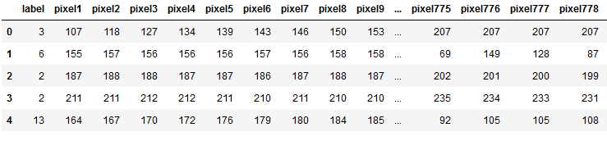
Mnist_Signs
The dataset has 784 data rows and single target row.

Slide 6
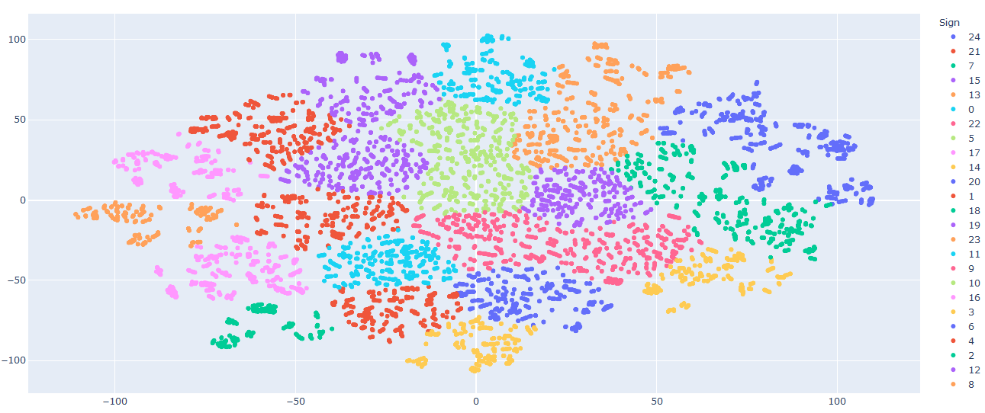
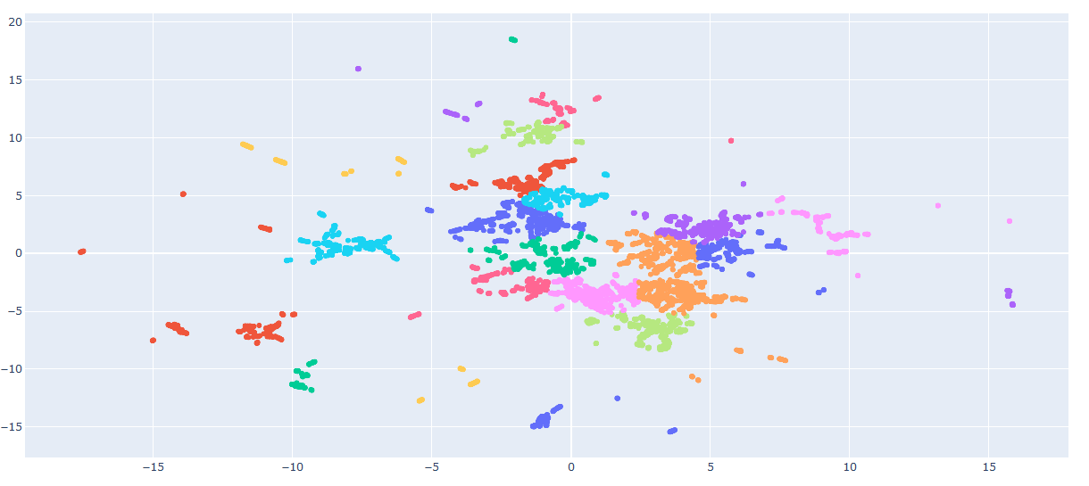
K-Means( TSNE-top vs UMAP-bottom)

Slide 7
Conclusion
The UMAP dimensions have very clear distance and
The regional clusters are very distinct. This indicates
That for this dataset the selection of dimensionality
Reduction makes a huge difference when we
Cluster the data.

Slide 8
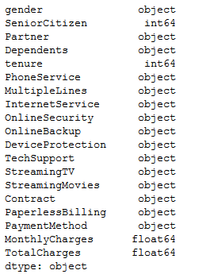
Customers
The dataset has 19 columns but no
Label/feature column.
Also many columns are object type
meaning strings, this is where we will
Use encoding to convert it into
Numerical data

Slide 9
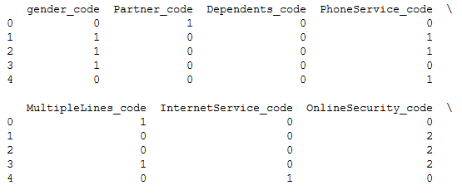
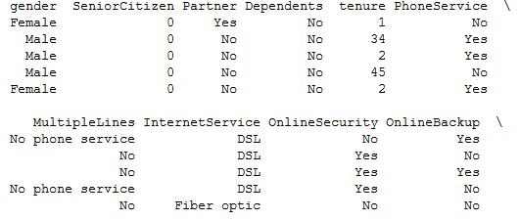
Data Pre-Processing
Data preprocessing is an important part of
data visualization information visualization in many graphs
Requires data in numerical form.

Slide 10
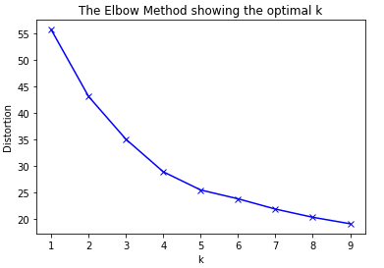
Unlabeled data problem
Since the data is unlabeled we have to
decide on optimal number of grouping
of clusters
We decide on 4 clusters.

Slide 11
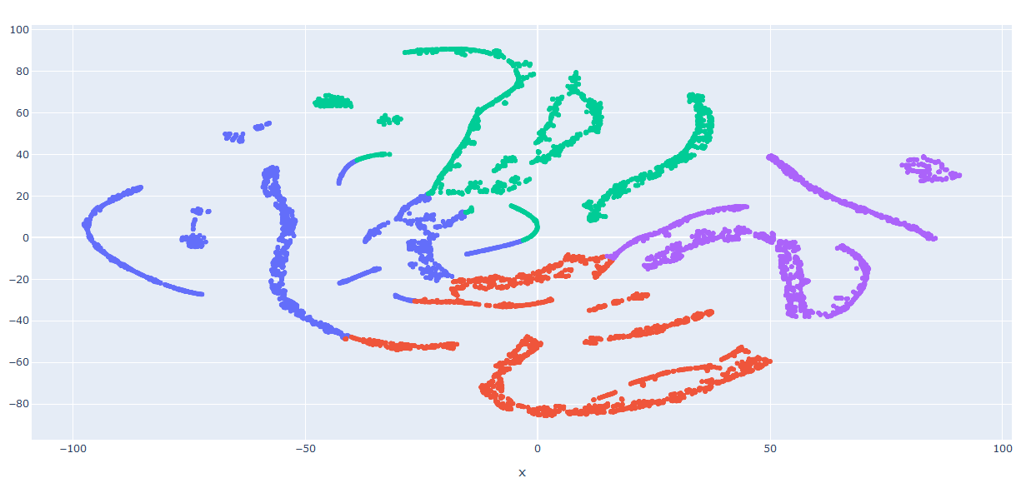
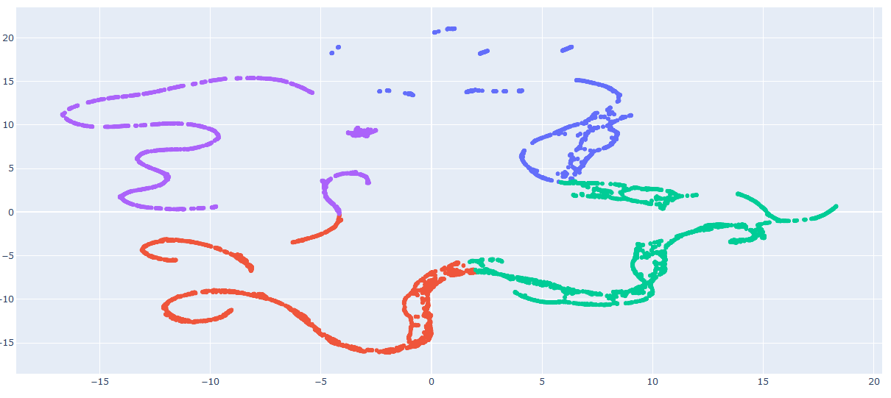
K-Means TSNE top vs. UMAP bottom

Slide 12
Conclusion
The results of UMAP are again more clear than TSNE.
However results are still more dependent on the
selection of a label column.

